Slide 1
Sensitization & Orientation on Partnership for Recovery and Resilience Area-Based Technical Engagement Processes
Tuesday, 24 September 2019

Slide 2
SESSION 1
Resilience Profiles

Slide 3
Resilience Profiles Study
The Resilience Profiles study was intended to bring evidence together to serve as a common reference for base lining, benchmarking and discussing priorities across and within PAs.
The objective of the Resilience Profiles Study was the profiling of community resilience as it relates to conflicts, livelihoods, poverty, shocks, markets, and their distinct impacts on men, women, children and elders to inform PfRR interventions.
Aside from demographic information it conveys the perception of respondents around issues deemed important by the Partners.

Slide 4
Resilience Profiles Study
Community Household Resilience Surveys completed by Management System International (MSI) in 2018;
Data collected from the seven Counties in South Sudan: Yambio (570), Awiel West, (643), Torit (445), Wau (622), Bor South (704), Yei (748) and Rumbek East (445);
Data were collected on basic services, trust and local institutions, and productive capacities;
Qualitative data gathered from FGDs with farmer groups, adult females, adult males, male youth, female youth, schoolteachers, community-based organizations (CBOs), government peace committees, faith-based organizations (FBOs), and key informant interviews with local leaders, chiefs, executive directors, teachers and peace committees.

Slide 5
Resilience Profiles Study – survey modules
Household characteristics
Livelihood sources and opportunities
Environment and natural disasters
Food security
Health and health care
Community participation
Community organization and community security
Conflict
Perceptions on governance, conflict and resources

Slide 6
Resilience Profiles Study – example of finding
In all counties except Wau, the majority of households mainly rely on crop farming

Slide 7
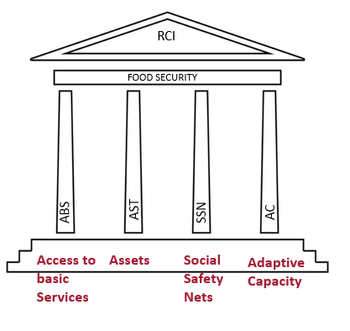
Resilience Measurement - RIMA
A quantitative approach that estimates household level resilience to food insecurity and generates evidence for more effectively assisting vulnerable population.
It explains why some households cope with shocks and stressors better than others and provides a rigorous framework for humanitarian and long-term development initiatives to build food secure and resilient livelihoods.
Household-level data measures household capacity to avoid stresses and shocks having long-lasting harmful effects.
Based on four pillars:

Slide 8
Resilience Measurement – Example of findings
Gender and resilience

Slide 9
Resilience Measurement – Example of findings
Drivers of resilience at community level: Adaptive capacities

Slide 10
Resilience Profiles Validation
The resilience profiles validation exercises are designed to elicit the views of the community with respect to the concurrence of the findings of the household study conducted in 2018 by USAID/MSI with the actual situation.
The stakeholders in the exercise need to concur that the findings of the resilience profiles study on the whole represents and reflects the realities in their community with few exceptions.
The validated findings should be used to inform and infuse the design of the various interventions and development initiatives through strong partnerships that will work toward reducing vulnerability and increasing resilience in partnership areas that is at the core of the PfRR.
The results are critical in institutional capacity development for improved governance, service delivery and increased economic productivity.
Lessons from the two validation exercises of the resilience profiles study in Aweil and Torit shows the critical role played by data and consequently evidence in informing development initiatives.

Slide 11
SESSION 2
Institutional Architecture for Recovery and Resilience (IA4R)

Slide 12
Institutional Architecture for Recovery and Resilience
A tool and processes that are used to assess institutional capacity to contribute to recovery and resilience.
One the fundamental PfRR Building Blocks

Slide 13
Why IA4R?
To get an indication of the capacity of specific types of institutions (such as UN Agencies, Ministries, Local Authorities, citizen interest groups, I/LNGOs, CBOs, FBOs, Development Committees, Associations and others), as well as the processes through which these institutions interact towards a common goal.
To establish the capacity to undertake transparent, inclusive, predictable, and evidence-based changes that are fundamental to improving resilience outcomes.

Slide 14
Objectives of IA4R within the PfRR Context
Build a shared understanding of institutional architecture for Recovery and Resilience (IA4R).
Participate together in self-assessment and deliberations within PAs IA4R areas of inquiry.
Prioritize PAs IA4R actions for improvement.
Reach consensus on a detailed prioritized PAs IA4R Improvement Plan.

Slide 15
Components of IA4R
Identification of critical institutions (Linked to RPs)
Establishment of the Strengths, weaknesses and capacity gaps of institutions
A tool for Assessing Institutions
Development of an Institutional Improvement Action Plan

Slide 16
Institutional Strengths, Weaknesses, Capacity Gaps and Interventions
INSTITUTION | STRENGTHS | WEAKNESSES | CAPACITY GAPS | PROPOSED INTERVENTIONS

Slide 17
IA4R Tool
..\..\Torit\Torit IA4R\IA4R Tool_Torit_September9th_ 2019.docx

Slide 18
Results from Administration of IA4R Tool

Slide 19
Institutional Architecture: Pillar 1 Baseline
 | Score(%)
Absorptive Capacity | Red | Yellow | Green
Institution is present and provides security, peace building, reconciliation, social cohesion, conflict resolution and rule of law on a regular basis
County Department of Local Government | 16.7 | 72.2 | 11.1
State and County Legislative Councils | 44.4 | 44.4 | 11.1
Peace Committees | 36.8 | 57.4 | 5.3
Traditional Authorities | 15.8 | 73.7 | 10.5
NGOs, CBOs, FBOs | 13.6 | 59.1 | 27.3
Adaptive Capacity
Institutions are shock aware (identified primary shocks & stressors, that impact the local community)
County Department of Local Government | 50.0 | 27.8 | 22.2
State and County Legislative Councils | 35.7 | 42.9 | 21.4
Peace Committees | 40.0 | 53.3 | 6.7
Traditional Authorities | 35.7 | 35.7 | 28.6
NGOs, CBOs, FBOs | 0 | 61.1 | 38.9
Transformative Capacity
Institutions’ stakeholders participate in preparedness and response planning
County Department of Local Government | 38.9 | 50.0 | 11.1
State and County Legislative Councils | 43.8 | 43.8 | 12.5
Peace Committees | 40.0 | 46.7 | 13.3
Traditional Authorities | 66.7 | 26.7 | 6.7
NSAs (NGOs, CBOs, FBOs, ) | 15.8 | 42.1 | 42.1

Slide 20
Institutional Improvement Action Plan
Concrete Action or Activity (must be a low hanging fruit) | Why it is important to do this (also link to IA4R framework elements) | Sub-activities – the steps or smaller activities that need to be taken | Timeline for delivery (short term < 6 months; medium term = 1 year; long term 2 years) | Lead implementer & others who’ll be involved (start with lead and list partners/ collaborators)

Slide 21
Key Lessons from IA4R
It provides for identification, assessment and development of interventions to fill capacity gaps for institutions that are critical for the success of PfRR
It lays the ground for Activity mapping
Assists in the development of the JWP

Slide 22
SESSION 3
Inclusive Champions Group

Slide 23
Inclusive Champions Group (ICG)
Overview of the Inclusive Champions Group
Inclusive Champions Group (ICG) is the leadership body operating across all levels to provide vision, raise community awareness, represent and connect their Partnership areas with the outer constituency, and leverage resources and ensure full and inclusive participation internally and externally.
It is agreed that an effective, passionate and dedicated ICG, combining different forms of knowledge, will help create an enabling environment for partners to work collaboratively despite the challenges.
The ICG is made up of a group of local stakeholders representing the various demographics and categories within the Partnership areas selected and mandated to represent their various constituencies in the planning, implementation, monitoring and propagation of the ideals and programs of the Partnership for Recovery and resilience within the partnership areas.

Slide 24
Inclusive Champions Group (ICG)
Who are the ICG?
Voluntary, dedicated, experienced & with Integrity, Committed and willing to participate and contribute towards the resilience agenda within the PA’s
Why is the ICG important?
Partnerships are based on Mutual trust, dedication, commitment and inclusiveness; in driving the partnership agenda, there is need for all stakeholders within the partnership areas to feel that they belong and that their voice is heard and their perspectives shared. The ICG represents these various constituencies and they pretty much play the oversight role. Besides oversight, they also ensure that there is commitment and accountability of the processes and the structures developed jointly and collaboratively.

Slide 25
REPRESENTATION:
Commerce and Industry
Faith Based Organizations
INGO’s
NNGO’s
UN Entities/Agencies
Local Gov’t (Including the Gov’t, line ministries and depts.)
Chamber of commerce
Traditional Authorities
Peace Committees and Peace Commission
Academia/Universities/research
Education/Health
CRITERIA:
Representatives and staff members mandated to make decisions on behalf of their org’s/agencies
Members who can implement decisions made
Leadership skills
Influence
Commitment and dedication to the PfRR agenda
Available and able to focus time and energy on the PfRR activities
Able to Protect each other in the champions group and protect the process (PfRR)
Able to promote and foster inclusivity and collaboration
Team player willing and able to participate in Joint planning
Objective, open and charismatic
The champions group should undertake to carry out a political Economy Analysis on the various institutions and frameworks to better engage and also highlight and prioritize key issues areas to focus on.
PUTTING COMMUNITIES AT THE CENTRE OF RESILIENCE

Slide 26
Champions for Change Training
The Champions for Change training aims to create a network of individuals at the community level who champion ideals, principles and processes that promote communities’ own agenda in the sustainable development processes in South Sudan.

Slide 27
By the end of the training, participants should be able to:
Develop a shared understanding of the global, regional and national contexts of addressing resilience and recovery programming among pastoral communities;
Identify the impact of drought related risks on livelihoods and key drivers of the ASAL economy;
Increase the capacity of state and non-state governance institutions in the PA’s to manage risks and vulnerability;
Acquire transformative leadership skills to manage and champion change in their PA’s and in South Sudan;
Apply a strategic thinking framework to identify priorities while planning programs on resilience and recovery;
Explore the concept of mutual accountability and the use of joint stakeholder reviews to enhance accountability and participation of stakeholders;
Consolidate lessons learned from locally developed and implemented initiatives on resilience and recovery and use these lessons to inform and (re)shape State level and county level policies.

Slide 28
Day 1 | Day 2 | Day 3 | Day 4
Time: 0800 – 0830 Registration | Review of Previous Day Time: 0800 – 0830 Review of previous day and Agenda for the day | Review of Previous Day Time: 0800 – 0830 Review of previous day and Agenda for the day | Review of Previous Day Time: 0800 – 0830 Review of previous day and Agenda for the day
Session 1 Time: 0830 – 1000 Welcome and Introductions – Building the Team | Session 4 Time: 0830 – 1030 Leading & Managing Change - Highlights of Kotter’s Eight Steps | Session 7a Time: 0830 – 1030 Community-based Healing & Trauma-Informed Peace-Building | Session 9 Time: 0830 – 1030 Developing our Resilience Story
TEA AND COFFEE BREAK
Session 2 Time: 1030 – 1230 Development, Dependency and other related concepts. | Session 5 Time: 1100 -1300 Leading Change- Steps 1 & 2 | Session 7b Time: 1100 -1300 Community-based Healing & Trauma-Informed Peace-Building | Session 10 Time: 1100 -1300 Transformational Leadership Action Planning
LUNCH BREAK
Session 3 Time: 1400 – 1600 Global and regional development Frameworks. | Session 6 Time: 1400 – 1600 Strategic Thinking and Planning | Session 8 Time: 1400 - 1600 Stakeholder Analysis, Mapping, and Messaging | Session 11 Time: 1400 – 1600 Wrap up and Closure Graduation & Award of Certificate
TEA AND COFFEE BREAK
Departure | Departure | Departure | Departure

Slide 29
SESSION 4
Program Framework

Slide 30
Program Framework
Program Framework is seen to be a tool for good management of activities within the partnership areas and anchored on the four pillars of the PfRR.
The management of activities in the PA’s is only effective and attainable through stronger coordination and inclusive mechanisms.
The Program Framework is therefore a road map developed jointly by the stakeholders within the PA, to map out their key priority resilience agenda and how to achieve them.

Slide 31
The PF helps the stakeholders to understand the bonds that bind them in the partnership areas through the analysis of the links and bonds between stakeholders in the Partnership Areas.
The PF also helps to streamline and define common goals and perspectives around Resilience issues within the PA’s. It also helps members to identify and prioritize major areas of action to be included in joint PfRR framework for the Partnership Area
Every PA therefore develops its own Common Agenda (Ex. 11, 9 Point Agenda).

Slide 32
Example: PF - Aweil

Slide 33
SESSION 5
Inventory and Mapping

Slide 34
Inventory and Mapping
Apart from mapping who is doing what, where and on to what scale, identifying and mapping exercise also helps the PfRR to identify the community assets available and how they can be harnessed.
Mapping can be used as a foundation for community improvement.
Where external resources (e.g., Donor or state money) or grants may not be available. Therefore, the resources for change must come from within each community. Identifying and mobilizing community assets enables community residents to gain control over their lives.
Improvement efforts are more effective, and longer-lasting, when community members dedicate their time and capacities or talents towards the changes they desire as in the case of the ICG.
It’s impossible to fully understand the community without identifying its assets. Knowing the community's strengths makes it easier to understand what kinds of programs or initiatives might be possible to address the community's needs.
When efforts are planned on the strengths of the community, people are likely to feel more positive about them, and to believe they can succeed. It's a lot easier to gain community support for an effort that emphasizes the positive - "We have the resources within our community to deal with this, and we can do it!" - Than one that stresses how large a problem is and how difficult it is to solve.

Slide 35
Inventory and Mapping
Partners identification and mapping does shows who is where, doing what and to what scale they operate in. This makes its easier for collocation and layering efforts to take place and thus enhance the quality and impact of their collective efforts.
Good Identification and mapping exercise of resources, vulnerabilities, resilience and partners can:
Show why and how some households cope with shocks and stressor better than others.
Be used for monitoring and for impact evaluation analysis: attribute change in resilience capacity to certain interventions enabling donors and partners to see where they can have the biggest impact
Be used for targeting: WHO is most in need, WHERE should investments focus( geographical)

Slide 36
EVIDENCE CALLS FOR HOLISTIC RECOVERY AND RESILIENCE INTERVENTIONS
BASED ON THE ANALYSIS, THE PfRR CAN IMPACT ON THE PILLARS AND THEIR CORRESPONDING VARIABLES TO ACHIEVE BETTER RESILIENCE OF THE HOUSEHOLDS AND THE COMMUNITIES
CALL FOR IMPROVEMENT OF DATA COLLECTION SYSTEM, INCREASING THE NUMBER OF INDICATORS REQUIRED FOR RESILIENCE MEASUREMENT AND ANALYSIS IN THE FSNMS

Slide 37
SESSION 6
Local Leaders and Champions Commitment

Slide 38
Commitments – Yambio Case Study
Partners’ understanding of commitments is growing from finance-centric to a more comprehensive and fundamental framing of an enabling environment. Existing resources are being realigned around pillars but donors are still urged to launch new PfRR projects.
Examples of strong commitments are cited at an agency level but a more systematic approach to commitments-setting can strengthen accountability at different levels. Flexibility differs by organization, project, contract and mechanism.

Slide 39
While partners have been as flexible as possible in the field, donors are asked to show their commit to greater flexibility. With partners committing to accountable performance management, the PfRR can evolve a rapid response to innovative ideas as convergence points.
Actions: (Yambio Case Study)
A process for determining mutual commitments to be set.
Commitments based on the 4-pillars and the coordination system to be established.
Donors commitments to include both resources and means to enhance flexibility.

Slide 40
SESSION 7
Joint Work Planning

Slide 41
The Joint Work Plan
Objective: Operationalize the four Cs (colocation, coordination, collaboration and commitment) in Yambio.
Overarching theme: Convergence of people, ideas, resources and efforts.
A working tool: Includes Results, Logical Frameworks, Cooperation Mechanisms, Key terms, relevant institutional architecture, M&E and other instruments for planning and operations.
Inclusive, participatory process directed by Co-Leads and Pillar Leads with professional facilitative support (53 agencies, 95 participants).
Notes:
Repeat from shocks slide. Equations estimate the relationships between Main driver of change in hunger is drought.
Baseline levels of absorptive and adaptive capacity help reduce to the probability of hunger in early to middle stages of drought.
Higher levels of resilience capacities (measured in rounds 1 and 2) improved hunger in round 3 during late stages of drought.
Change in R3 is due to lower drought but also higher levels of resilience capacities in R1 and R2.
Humanitarian assistance also reduced hunger. (but did not affect recovery)
Questions remain: What about transformative And which elements are absorptive and adaptive capacities matter most?

Slide 42
What was Done?
10 Framing Questions:
Shared understanding: do partners have a shared understanding of the basic concepts framing the Partnership?
Greater impact: What are the results that would produce the greatest impact in reducing vulnerability and building resilience in Yambio?
Inventory of Partners’ activities: Do we know what partners are currently doing in Yambio, where their activities are located, how long they will be active and what assets they have available?
Convergence in practice – Can we layer, sequence and cluster our activities in Yambio better for greater impact through strategic integration?
Co-location – Can we identify sub-county (payam and/or boma) level geographic targets on which to converge our efforts for greater impact?
Coordination – Can we prioritize the most critical activities needed to stand up the Partnership in Yambio, commit to firm dates and allocate core responsibilities and resources?
Collaboration and adaptation – Can we suggest to our donors any financing and/or compliance adjustments to make strategic integration and high impact programming more viable in Yambio?
Outreach and consensus building – What should the Partnership in do in order to ensure that there is solid agreement and consensus on the Consolidated Workplan and the Partnership layering Strategy/plan for Yambio
Socialization of tools – Are we familiar with the key documents and tools that relate to the Partnership?
The Collective Impact Approach – Could the Partnership use this approach to structure backbone support that upholds the distributed authority across the Partnership?

Slide 43
What was Done?
The Logical Framework - participants spiraled back on previous work to refine results and associated logical frameworks.
Learning while planning ensured knowledge co-creation (case studies, collaborative definition of key terms).
Presentation of Resilience Profiles and RIMA Plus grounded the planning in evidence.
Small discussion groups cascading up into Pillar groups and further into plenary (maximize ownership and input).
Inclusive, participatory process directed by Co-Leads and Pillar Leads with professional facilitative support.

Slide 44
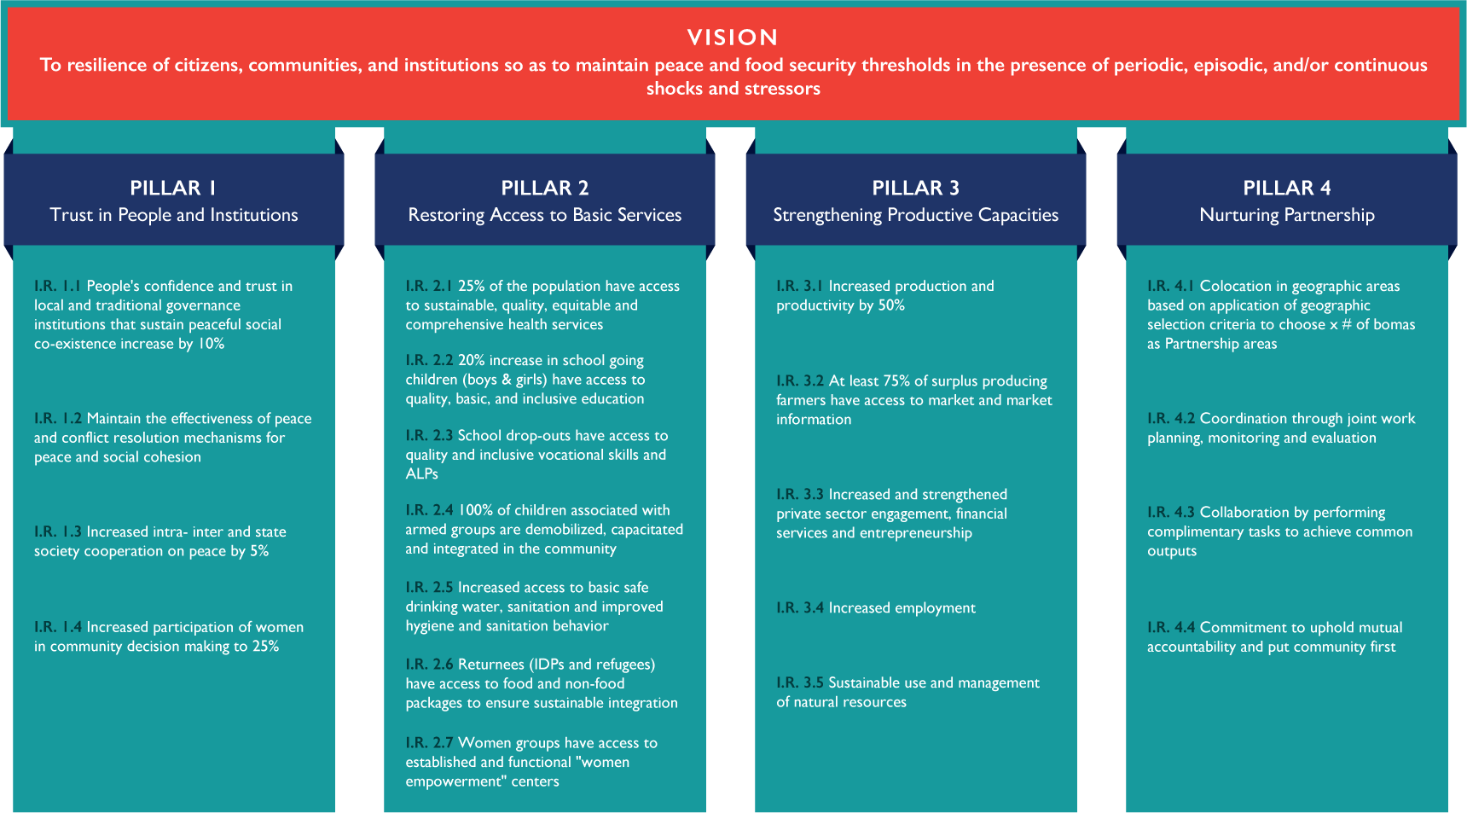
What Results were Prioritized?
Notes:
Repeat from shocks slide. Equations estimate the relationships between Main driver of change in hunger is drought.
Baseline levels of absorptive and adaptive capacity help reduce to the probability of hunger in early to middle stages of drought.
Higher levels of resilience capacities (measured in rounds 1 and 2) improved hunger in round 3 during late stages of drought.
Change in R3 is due to lower drought but also higher levels of resilience capacities in R1 and R2.
Humanitarian assistance also reduced hunger. (but did not affect recovery)
Questions remain: What about transformative And which elements are absorptive and adaptive capacities matter most?

Slide 45
How was Evidence factored in to JWP?
 | KEY RESULTS | Baseline levels % | % increase targeted | Indicators
Pillar 1: | Rebuild Trust in Institutions and People
Intermediate Result 1.1 | People's confidence and trust in local and traditional governance institutions that sustain peaceful social co-existence in Gbudue state increase by 10% by 2019 | (60% for traditional Authority) (50% for local government) (38% for Paramount chiefs) | 10% of each | % of respondents who cite various institutions as relevant in their daily lives
Intermediate Result 1.2 | Maintain the effectiveness of peace and conflict resolution mechanisms for peace and social cohesion | 90% (Dialogue) | Maintain % | Baseline (90% of dialogue) Indicator for peace- IGAD CTYSAM- # of violations on the peace agreement. Number of incidents of intercommunal conflicts
Intermediate Result 1.3 | Increased intra- inter and state society cooperation on peace by 5% in 2019 | 0.147, -0.24, 0.147 | 5% increase | Social capital scores for inter-communal (bonding), inter-communal (bridging) and state-society (linking)
Intermediate Result 1.4 | Increased participation of women in community decision making to 25% by end 2019 | 17% | 25% increase | percentage of women respondents who report having been seriously involved in decision making
Notes:
Repeat from shocks slide. Equations estimate the relationships between Main driver of change in hunger is drought.
Baseline levels of absorptive and adaptive capacity help reduce to the probability of hunger in early to middle stages of drought.
Higher levels of resilience capacities (measured in rounds 1 and 2) improved hunger in round 3 during late stages of drought.
Change in R3 is due to lower drought but also higher levels of resilience capacities in R1 and R2.
Humanitarian assistance also reduced hunger. (but did not affect recovery)
Questions remain: What about transformative And which elements are absorptive and adaptive capacities matter most?

Slide 46
What is the Impact?
Internalization of the four Pillars
Adoption of common language
Prioritization of key results
Identification of sub-CPA partnership areas
Adoption of convergence as a lens to operationalize the four Cs
Agreement on coordination structures at all levels starting with CDCs
Recognition of the need for evidence-based decision making
Commitment to work together across agencies and sectors

Slide 47
Recommendation
The JWP is only as good as its practical application. If the JWP can now serve as a living document, convergence of people, ideas, resources and efforts around agreed upon priorities will be more likely. That is why in addition to the results, a mechanism is proposed for more flexible and adaptive management.
Notes:
Repeat from shocks slide. Equations estimate the relationships between Main driver of change in hunger is drought.
Baseline levels of absorptive and adaptive capacity help reduce to the probability of hunger in early to middle stages of drought.
Higher levels of resilience capacities (measured in rounds 1 and 2) improved hunger in round 3 during late stages of drought.
Change in R3 is due to lower drought but also higher levels of resilience capacities in R1 and R2.
Humanitarian assistance also reduced hunger. (but did not affect recovery)
Questions remain: What about transformative And which elements are absorptive and adaptive capacities matter most?

Slide 48
SESSION 8
Coordination Planning

Slide 49
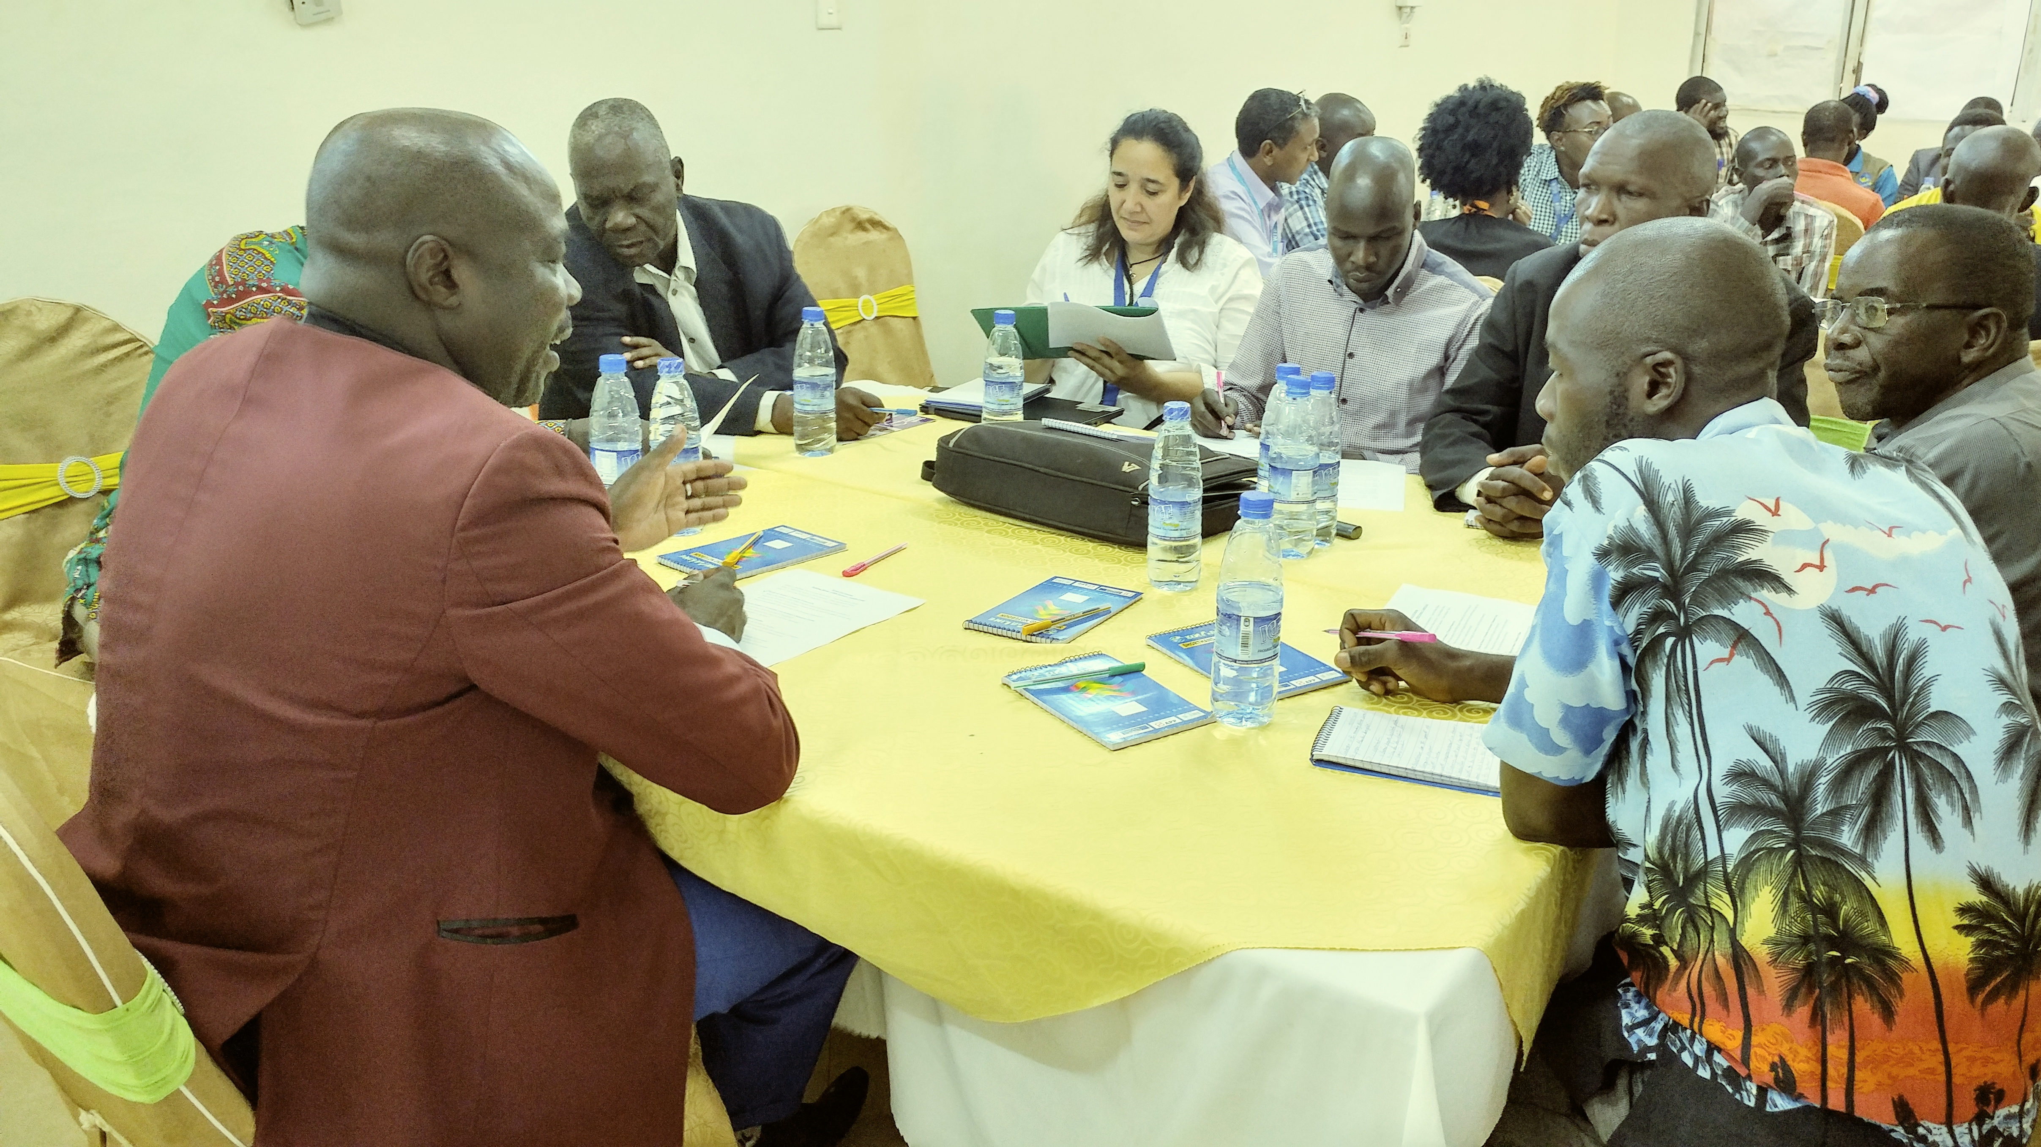
Coordination Planning
Key Takeaways YAMBIO Coordination
Workshop
Sept 11-12, 2019

Slide 50
Coordination Planning (CP)
Its generally agreed that a strong coordination will minimize resource duplication, facilitate mobilization of resources, enhance mutual accountability and create greater impact. For example in Yambio, the stakeholders recently endorsed the existing coordination structures, called for more clarity on how they operate and called for a coordination policy/plan

Slide 51
Workshop Recommendations
Strengthen the Office of the Coordinator
Create a stand-alone backbone support mechanism combining international and local capacity
Clarify a similar coordination structure at the Juba level
Establish a clear link to Juba and with an effective feedback loop
Activate the CDC participation as part of the process

Slide 52
Workshop Recommendations Cont’d
Define feedback loops at targeted levels – reporting, meetings, decision making points.
Articulate a clear work-flow process from ideas, through project design, proposal review, approval, contracting, disbursement, and implementation.
Establish a community-based M&E system that align roles and responsibilities from the CDC-level to the Juba-based M&E function.

Slide 53
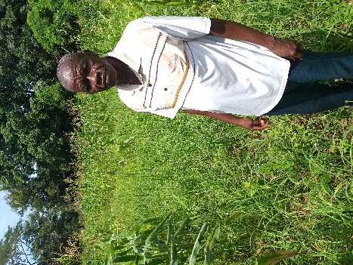
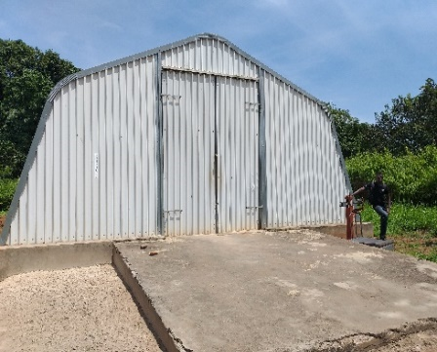
Field Visit Key Informant Interviews PfRR Best Practice / NAFA - Nzara
Convergence & Collocation Works – Mr. Samuel / Chair Union of Farmers demonstrates his field and Collection Center
Partners - WFP / FAO / WV / Local Community
Increased Production - from 50 kilos to 1,000 kilos
Increased price to 3,500 SS per 50 kilo bag
Grains Bought by WFP for use in feeding programs reducing costs of food aid and improving local production – availability of food

Slide 54
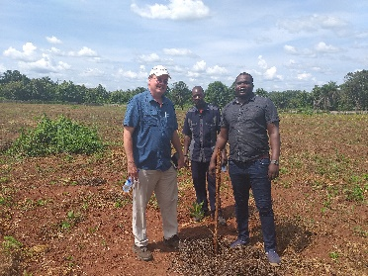
Convergence Opportunity Pillar 3 Nzara
Feedback from field visit – Converge around local economic growth opportunities to increase family revenues, deter youth from militias & stabilize communities as part of the peace process
Build off of best practices – Equatoria Teak Company, create a public private partnership

Slide 55
Introduce Supply chain development
Convergence Opportunity – Reactivate the Agro-Industrial zone in Nzara. To be done through a PPP / Community and ET
Target Supply Chains for Growth Potential – To include a supply chain analysis, negotiation of PPP’s and development of quality assurances, standards ie (Food Safety) Certifications – Global-GAP, GMP, HACCP, Sustainable / Organic Certs.

Slide 56
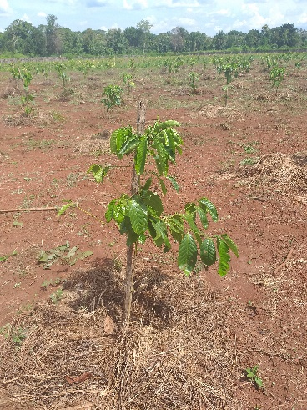
Potential Supply chains to target
PPP – Equatoria Teak
Sustainable Supply Chains – Coffee, Teak, Cashew, Vanilla, Macadamia
Partnership Research / Investigation Center WCR / IFPRI / CGIAR etc. “Development of Excelsior Rust Resistant Varieties”

Slide 57
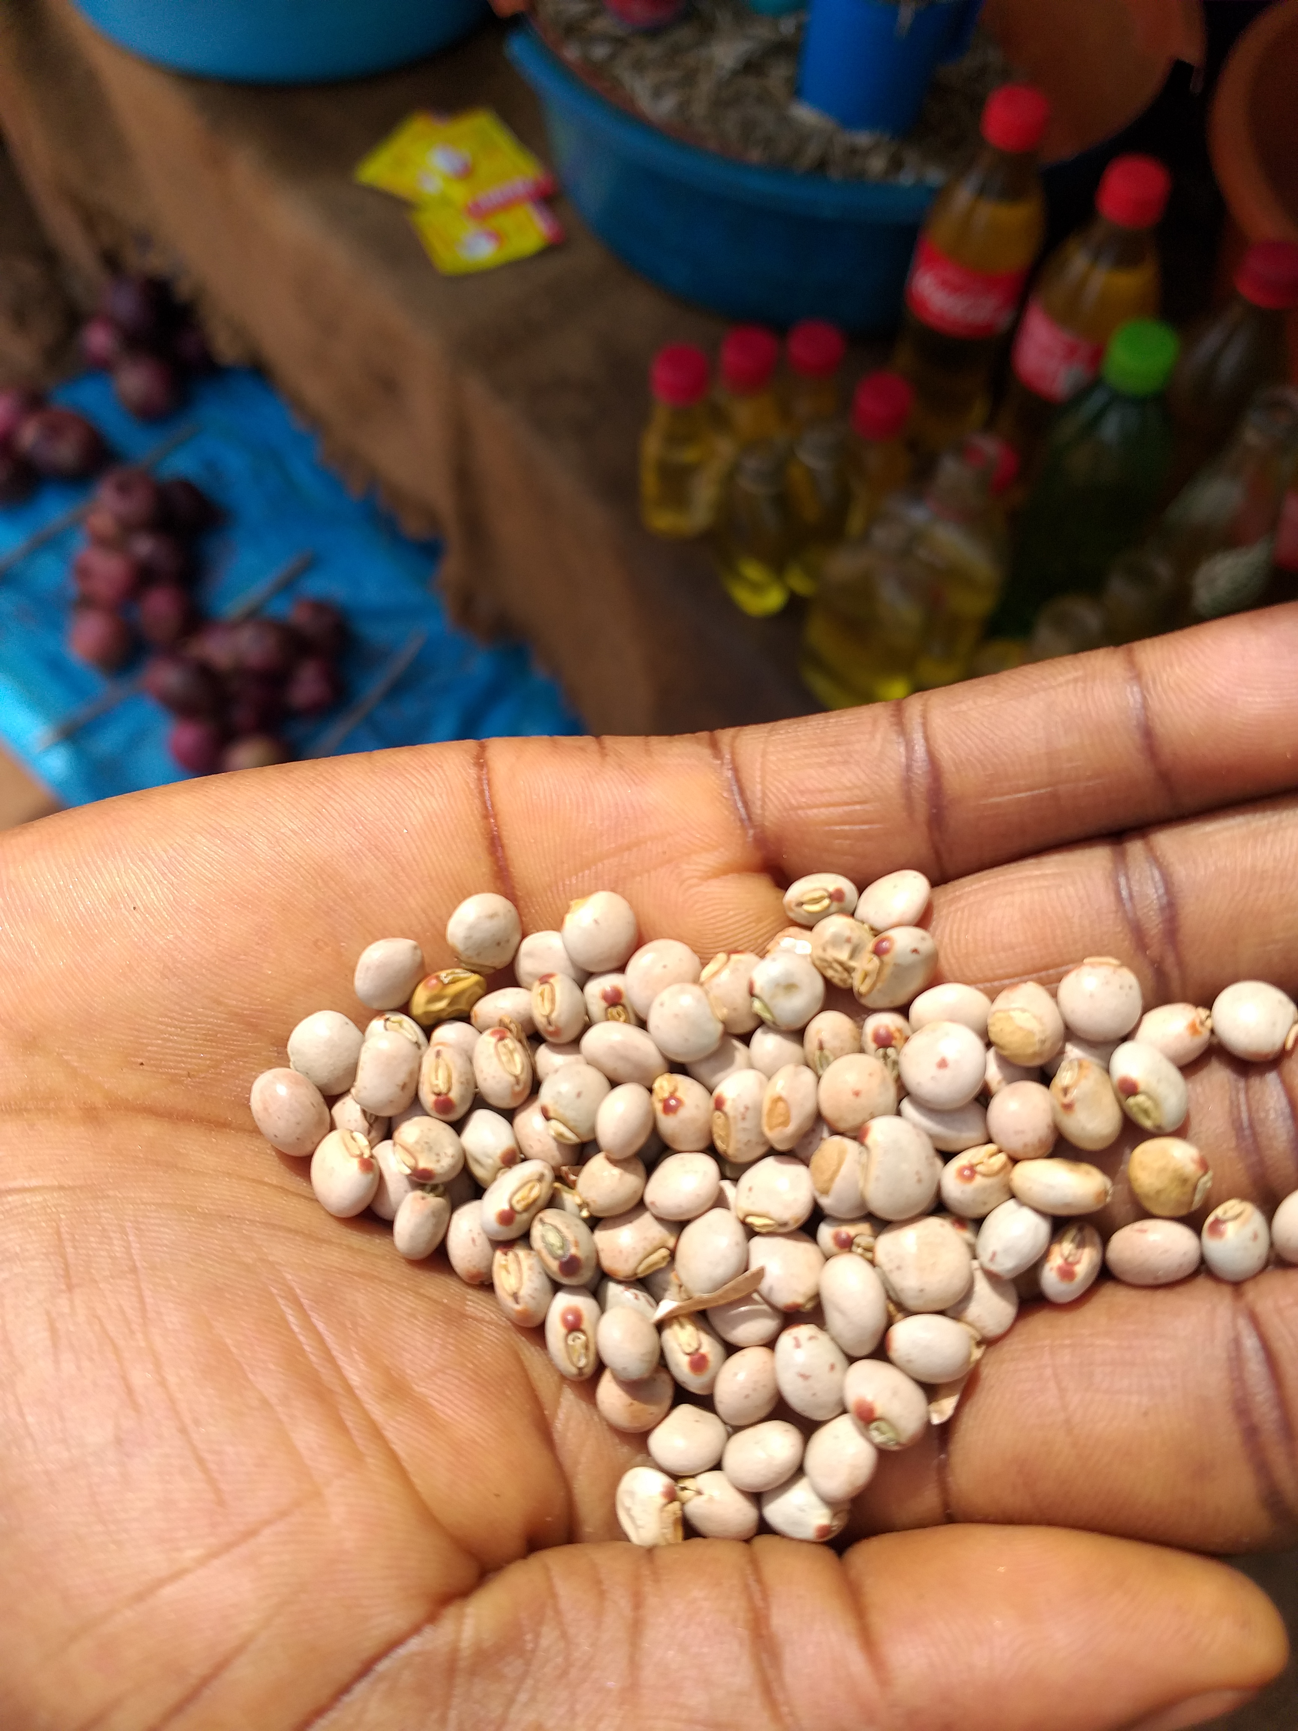
Potential Supply chains to target Cont’d
Agro-Industrial Zone Nzara
Pre / On-farm & Agroprocessing - Seasamee – Oil, Sustainable Cotton BCI certified
Current Partner Supply Chains + Native Varieties
Pre & On-farm - Sesame, Soy, beans, Cotton, Okra

Slide 58
Thank You

