Slide 1

Resilience Exchange Network
1 February 2018

Slide 2
Definitions of Resilience
Resilience is the ability of an individual, a household, a community, a country or a region to withstand, adapt and to quickly recover from stresses and shocks. (EU Communication on Resilience)
Disaster Resilience is the ability of countries, communities and households to manage change, by maintaining or transforming living standards in the face of shocks or stresses - such as earthquakes, drought or violent conflict - without compromising their long-term prospects. (DFID)
The ability of people, households, communities, countries, and systems to mitigate, adapt to, and recover from shocks and stresses in a manner that reduces chronic vulnerability and facilitates inclusive growth. (USAID)

Slide 3
Definitions of Resilience
Community resilience is ‘the ability of all vulnerable households or individuals that make up a community, to anticipate, respond to, cope with, and recover from the effects of shocks, and to adapt to stresses in a timely and effective manner without compromising their long-term prospects of moving out of poverty. (Concern Worldwide)
The ability of communities and households living within complex systems to anticipate and adapt to risks, and to absorb, respond and recover from shocks and stresses in a timely and effective manner without compromising their long term prospects, ultimately improving their well-being (Goal).

Slide 4
Objectives of Today’s Meeting
To identify resilience actors in South Sudan
To establish whether there is interest in forming a network or platform to discuss resilience in South Sudan
If so, to agree on actions to take such an initiative forward.

Slide 5
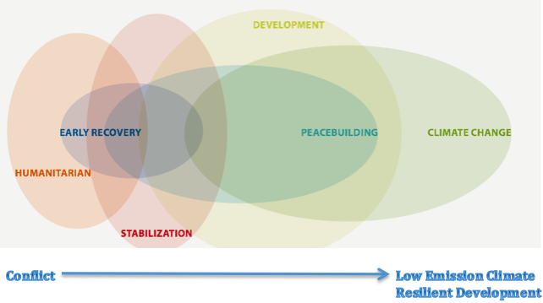
Harmonizing resilience-related financing in South Sudan
Notes:
Financing Recovery for Resilience (Adapted from UNDP, 2014) Bayat-Renoux, F., & Glemarec, Y. 2014.
Enhancing the coverage, capitalization and coherence of pooled financing mechanisms for recovery to strengthen synergies between humanitarian, development and climate finance
UNDP Pg 17.

Slide 6
Growing Momentum on Resilience
Dialogue on Building Resilience to Hunger in South Sudan (24th and 25th October) - Agriculture Livelihoods Donor Working Group (ALDWG)
Common Understanding of the Problem and the Vision Leading to Common Definition of Resilience: FAO and WFP to lead a working group to develop a common vision of what resilience means in the context of South Sudan. This will include identifying the scope of the resilience agenda, the target sectors and possible joint programming options.
Testing of New Business Models for Multi-Sector Resilience Programming: USAID to test a model of multi-sector resilience-building at the local level in pilot regions of the country.
Information Sharing and Learning: DFID, Canada and the EU, to lead the development of a learning agenda on resilience and establish an information-sharing mechanism
Resilience Measurement: FAO/WFP in partnership with UNICEF, REACH and FEWSNET to develop a methodology to effectively measure resilience.
Keep the Momentum of a “Resilience Conversation”: FAO and WFP, in collaboration with the ALDWG and the humanitarian coordination leadership, to work towards mainstreaming the resilience agenda within and across the development and humanitarian interventions

Slide 7
Principles of Resilience Programming
Leadership
Shared understanding of resilience
Programming based on a multi-hazard risk analysis
Engaging with vulnerable people, communities, and linking communities to all levels and stakeholders
Investing in capacity
Process-oriented approach
Coordinated approaches
Promoting protection mechanisms
Addressing inequality
Linking to early warning systems
Starting with the EXIT strategy

Slide 8
Proposed Objectives of the Network or Platform
Developing a common understanding of resilience: what principles guide effective resilience programming?
What are the challenges of resilience programming?
Identifying the scope of resilience programming across actors and mapping of project locations and actors in South Sudan
Information sharing and learning to develop a learning agenda on intervention models, good practice, innovations and value for money
Explore measurement of resilience programming and how this differs from conventional M&E Tools
6. Mainstreaming the resilience agenda within and across development and humanitarian interventions in South Sudan

Slide 9

What now??
Interest in network or platform?
Current actors in resilience programming?
Next steps
  Lead agency(ies) / committee
  Development of terms of reference
  Frequency – who to include
  Identification of priority areas for discussion
  Presentations by current resilience actors – successful interventions/challenges
  Mapping of resilience actors
  Development of a set of principles for resilience in South Sudan
Notes:
Trust and collective action – seed contribution, granary construction

Slide 10







IRISS – Improving Resilience in South Sudan

Slide 11
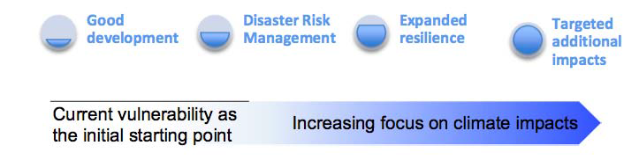
Continuum of adaptation actions
Good Development | Good Development | Disaster Risk Management | Expanded Resilience | Targeted Additional Impacts
Improved Agriculture and Diversified Livelihoods | Social Protection Mechanisms | Adaptation and Disaster Management Planning | Climate Smart Technologies | National Climate, DRR and Agriculture Policy

Slide 13
Comparative Advantage of Consortium Members
The Sudd Institute
Concern Worldwide
ACTED
FAO
UNEP
SNV
Technical Input
Field level implementation
Experiential Learning
Evidence based on robust M&E
National and International Engagement
Research
Engagement with National Government
Technical Support (later withdrew from South Sudan)
State of the Environment Report
National Consultations
International engagement
Lead Agency

Slide 14
BRACED MULITI-LEVEL APPROACH
(Building Resilience to Climate Extremes and Disasters)
SCHOOL ENVIRONMENT CLUB
VALUE CHAIN DEVELOPMENT
AGRO-PASTORAL FIELD SCHOOL
VOLUNTARY SAVINGS & LOAN ASSOCIATION
CASH-FOR-ASSETS (BRACE II)
CLTS
Community and Household Levels
COMMUNITY RESILIENCE PLANNING COMMITTEE
GLOBAL PLATFORM
Adaptive Resilience Programming
UNEA
International Level
WEATHER FORECASTING MODEL
Payam, County and State level
COP UNFCCC
EARLY WARNING SYSTEM
National Level
ADVOCACY
POLICY ENGAGEMENT
RESEARCH

Slide 15
Key Lessons Learnt
Resilience interventions are feasible in South Sudan - flexibility needed to tailor to local context and adjust to changing circumstances
BRACED introduced new knowledge and practice around agriculture, NRM, sanitation, saving and credit, business
Shift of mindset (dependence to self-reliance), greater community cohesion, and reduced conflict
Improved resilience to shocks, but still vulnerability
Introduction of CfA showed responsiveness and flexibility; though some question marks over quality/durability of the assets
A substantial contribution has been made to the evidence base on Climate Change in South Sudan; some influence on policy and programming and signs of more to come
Would have benefited from stronger phasing
Overall, a trailblazing programme which provides a foundation for future resilience work.
Notes:
Trust and collective action – seed contribution, granary construction

Slide 16
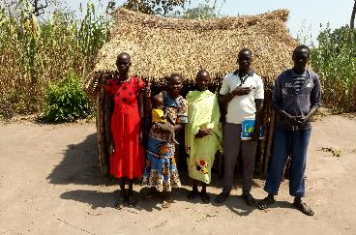
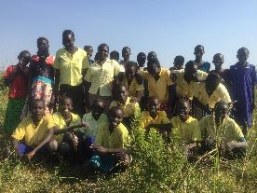
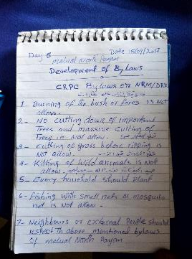
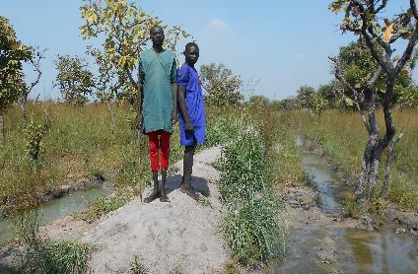
Photo Gallery
Mariik primary school environment club, Aweil
APFS group members outside store: Kuanja, Tonj South
By-laws developed by CRPC: Held by Payam Administrator, Malual North Payam, Aweil North
Cash for Assets: Dyke, Nyiel, Tonj South

