Slide 1
Resilience Index Measurement and analysis Model-II
RIMA-II
Resilience Exchange Network
Venue: NGO Forum
Date27th March 2018
Owen Calvert
Project Manager
Sustainable Agriculture for Economic Resiliency
Juba, South Sudan
Food and Agriculture Organization of the United Nations

Slide 2

Resilience measurement at FAO
The RIMA-II model

Slide 3
RIMA (Resilience Index Measurement and Analysis) is an innovative quantitative approach that estimates resilience to food insecurity and
generates the evidence for more effectively assisting vulnerable populations.
RIMA allows explaining why and how some households cope with shocks and stressor better than others do and provides rigorous framework for humanitarian and long-term development initiatives to build food secure and resilient livelihoods.
The RIMA model

Slide 4
RIMA perfectly suits several definitions of resilience:
The ability to prevent disasters and crises as well as to anticipate, absorb, accommodate or recover from them in a timely, efficient and sustainable manner (FAO, 2013)
The capacity of a household to bounce back to a previous level of well-being (for instance food security) after a shock (Alinovi, Mane & Romano, 2009)
The capacity that ensures adverse stressors and shocks do not have long-lasting adverse development consequences (Resilience Measurement Technical Working Group of the Food Security Information Network, 2014)
Defining resilience

Slide 5





Operationalization of FSINs Adaptive, Transformative and Absorptive capacities
Household resilience
Resilience pillars
Social safety nets (SSN)
Access to basic services (ABS)
Assets (AST)
Adaptive capacity (AC)

Slide 6
Resilience pillars | Definition
Adaptive Capacity | Adaptive Capacity is the ability of a household to adapt to a new situation and develop new strategies of livelihood
Social Safety Nets | The Social Safety Nets pillar measures the ability of households to access timely and reliable assistance provided by international agencies, charities, and NGOs, as well as help from relatives and friends.
Assets | Assets comprise both productive and non-productive assets. Examples of indicators include land, livestock and durables. Other tangible assets such as house, vehicle, and household amenities reflect living standards and wealth of a household.
Access to Basic Services | Access to Basic Services shows the ability of a household to meet basic needs, and access and effective use of basic services; e.g., access to schools, health facilities; infrastructures and markets.
Resilience pillars

Slide 7
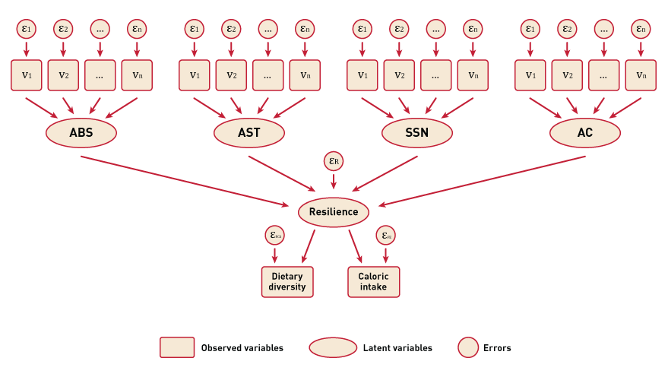
The procedure
RCI estimation

Slide 8
RESILIENCE ANALYSIS – western Equatoria
Food Consumption Score
FCS
FCS | Percent
Poor | 70
Borderline | 23
Acceptable | 7
Total | 100
FCS Desegregated by county
County | Poor | Border line | Acceptable | Total
Tambura | 63.8 | 26.3 | 10.0 | 100
Nzara | 68.8 | 27.3 | 3.9 | 100
Yambio | 78.5 | 15.2 | 6.3 | 100
Overall | 70.3 | 22.9 | 6.8 | 100
Notes:
Open the floor to qus

Slide 9
RESILIENCE ANALYSIS
Food groups consumption per week
Variable | Obs | Mean | Std. Dev. | Min | Max
CEREALS | 236 | 3.86 | 2.13 | 0 | 7
PULSES | 236 | 0.91 | 1.74 | 0 | 7
MILK | 236 | 0.17 | 0.78 | 0 | 7
MEAT | 236 | 0.62 | 1.05 | 0 | 7
VEG | 236 | 2.87 | 1.97 | 0 | 7
FRUIT | 236 | 0.34 | 0.86 | 0 | 7
SUGAR | 236 | 0.55 | 1.32 | 0 | 7
FISH | 236 | 0.08 | 0.28 | 0 | 2
Notes:
Two main food items regularly consumed are cereals and vegetables. Protein products are not frequently consumed

Slide 10
RESILIENCE ANALYSIS
Water Quality
Source of drinking water | %
Untreated water source/River | 44
Water from deep borehole fitted with a hand pump | 24
Tap water | 9
Surface water (run off, etc) | 20
Other(Rain water collected, Bottled water, treated tanker) | 3
Total | 100
Notes:
Open the floor to qus

Slide 11
RESILIENCE ANALYSIS
Water Time
It takes approximately an hour for a household member to fetch water from the main source.
Variable | Obs | Mean | Std. Dev. | Min | Max
Time taken to and from main water source | 236 | 52.52 | 49.78 | 0.6 | 345
Notes:
Open the floor to qus

Slide 12
RESILIENCE ANALYSIS
Shocks
SHOCKS | PROPORTION
Reduce Employment | 0.02
Reduced Income | 0.09
Illness/accident of key hh member | 0.28
Death of key hh member | 0.21
High food prices | 0.44
High fuel/transport prices | 0.19
Drought | 0.06
Pest and disease | 0.07
Violent insecurity | 0.45
Epidemics | 0.03
Notes:
Violent insecurity, high food prices illness of key household member and death of key household member came out as the main shocks

Slide 13
RESILIENCE ANALYSIS
RCI and Pillars
Notes:
Assets and Social Safety Nets are the main drivers of resilience

Slide 14
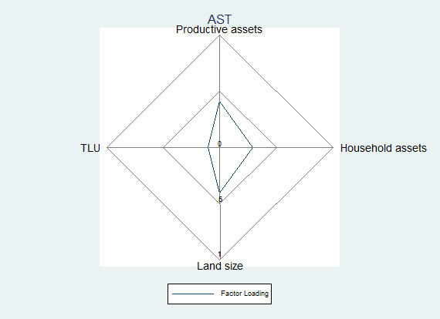
RESILIENCE ANALYSIS
RCI and Pillars
Notes:
Open the floor to qus

Slide 15
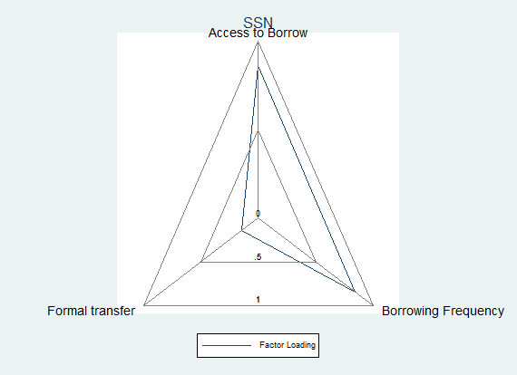
RESILIENCE ANALYSIS
RCI and Pillars
Notes:
Open the floor to qus

Slide 16
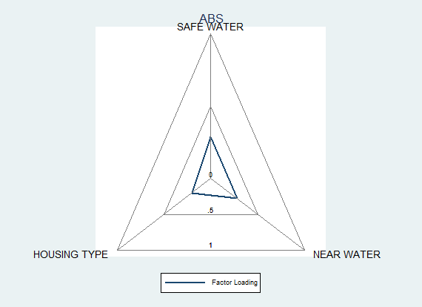
RESILIENCE ANALYSIS
RCI and Pillars
Notes:
Open the floor to qus

Slide 17
RESILIENCE ANALYSIS
Male vs. Female Resilience Capacity
Notes:
Open the floor to qus

Slide 18
RESILIENCE ANALYSIS
Average Resilience Index
 | Female Headed HH | Male Headed HH
RCI | 26.56 | 29.4
FCS | 17.11 | 18.72
HDDS | 3.385 | 3.784
Improved water | 0.0923 | 0.117
Distwater | 5.342 | 3.534
Productive ast | 0.272 | 0.235
Householdast | 0.797 | 0.986
Landsize | 1.738 | 1.842
TLU | 0.0245 | 0.0426
Accesscredit Borrow | 0.0923 | 0.0936
Accesscredit borrow freq | 0.0308 | 0.0585
Accesscredit Assistance | 0.0615 | 0.0468
Hhhedu | 3.092 | 5.491
Hhfedu | 3.8 | 2.246
Hhmedu | 2.523 | 6.298
Income | 1.031 | 1.234
Notes:
Male headed households have higher household resilience capacity compared to female headed households. Highlighted are things that could be explaining why male headed households have higher resilience than female headed households

